Slide 1

Build Docker Image Using Dockerfile
SinghamYuan R&D Ⅱ

Slide 2
Contents
Introduction
Concepts
Commands
Dockerfile
Demonstration

Slide 3
Introduction
Docker is a platform for developers and sysadmins to develop, deploy, and run applications with containers. The use of Linux containers to deploy applications is called containerization. Containers are not new, but their use for easily deploying applications is.
Containerization is increasingly popular because containers are:
Flexible: Even the most complex applications can be containerized.
Lightweight: Containers leverage and share the host kernel.
Interchangeable: You can deploy updates and upgrades on-the-fly.
Portable: You can build locally, deploy to the cloud, and run anywhere.
Scalable: You can increase and automatically distribute container replicas.
Stackable: You can stack services vertically and on-the-fly.

Slide 4
Why use docker？
More efficient use of system resources
Faster startup time
Consistent running environment
Continuous delivery and deployment
More relaxed migration
Easier maintenance and expansion
Characteristic | Container | Virtual Machine
Start-up | Second Level | Minutes Level
Hard Disk Use | 10s MB | 10s GB
Performance | Close to the original | Weaker
System Support | 1000s | 10s

Slide 5
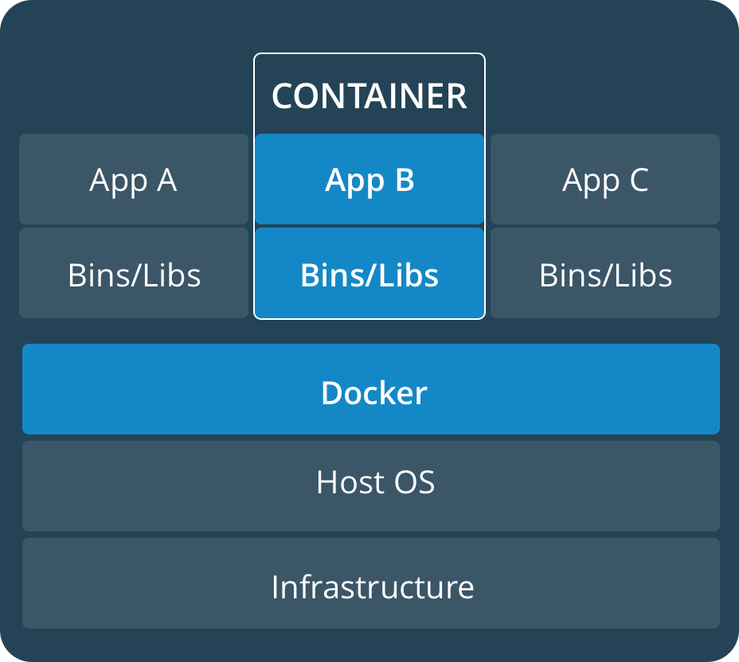
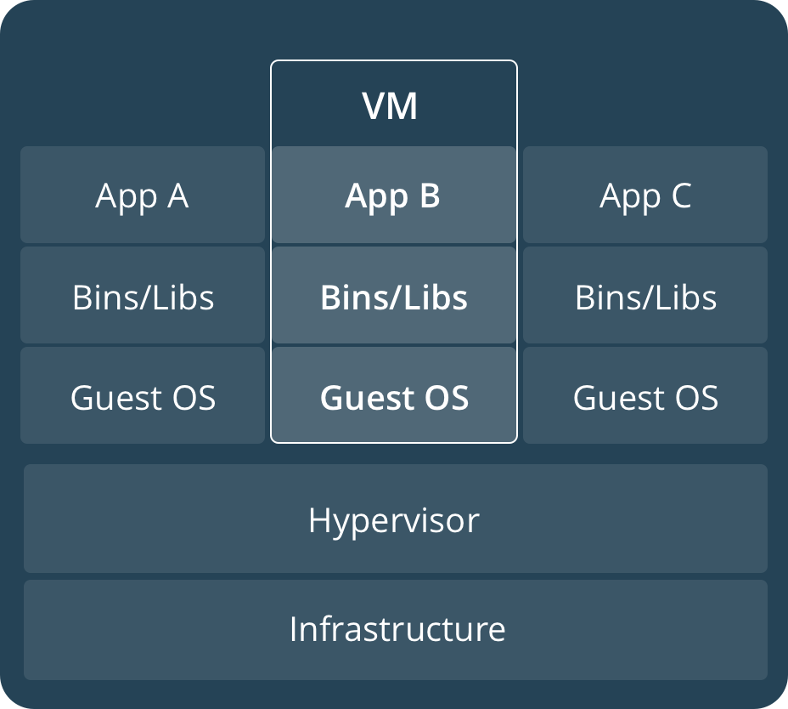
Comparison

Slide 6
Base Concepts
Image: An image is an executable package that includes everything needed to run an application--the code, a runtime, libraries, environment variables, and configuration files.
Container：A container is a runtime instance of an image. A container is launched by running an image.
Registry: A Registry is a hosted service containing repositories of images which responds to the Registry API. The default registry can be accessed using a browser at Docker Hub or using the docker search command.
Repository: A repository is a set of Docker images. A repository can be shared by pushing it to a registry server. The different images in the repository can be labeled using tags.

Slide 7
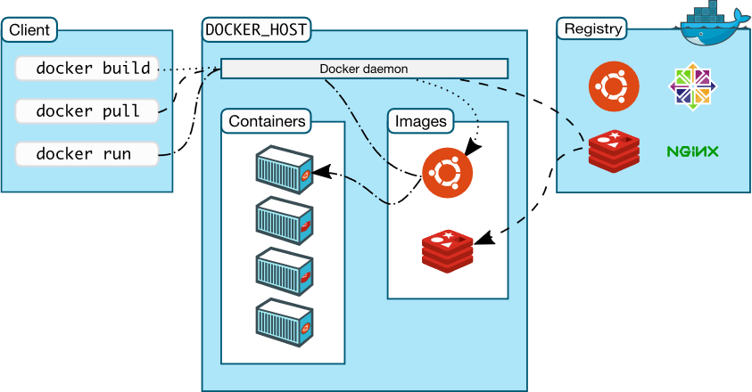
Architecture

Slide 8
Common Commands
docker --help
Image：
docker version、 info.
docker login 、 logout、 search、 pull、 push.
docker build、 images、 rmi、 tag、 save、 load、 import.
Container:
docker commit、 cp、 diff、 rename、 update.
docker create、 start、 stop、 restart、 run、 kill、 rm、 exec、 pause、 unpause.
docker ps [-a]、 inspect、 top、 attach、 wait、 export、 port.
Other：
docker volume、 network.
docker events、 history、 logs.

Slide 9
Dockerfile
Docker can build images automatically by reading the instructions from a Dockerfile. A Dockerfile is a text document that contains all the commands a user could call on the command line to assemble an image. Using docker build users can create an automated build that executes several command-line instructions in succession.
The docker build command builds an image from a Dockerfile and a context. The build’s context is the set of files at a specified location PATH or URL. The PATH is a directory on your local filesystem. The URL is a Git repository location.
A context is processed recursively. So, a PATH includes any subdirectories and the URL includes the repository and its submodules.

Slide 10
How to write a Dockerfile?
The Docker daemon runs the instructions in the Dockerfile one-by-one, committing the result of each instruction to a new image if necessary, before finally outputting the ID of your new image. So a Dockerfile is made up of instructions and the instruction is not case-sensitive.
Here is the format of the Dockerfile:
# Comment
INSTRUCTION arguments
Note that the first instruction in a Dockerfile must be “FROM”!!! The FROM instruction specifies the Base Image from which you are building. Docker treats lines that begin with # as a comment, unless the line is a valid parser directive. A # marker anywhere else in a line is treated as an argument.

Slide 11
Instructions
FROM、ARG、 LABEL
RUN、 CMD、 EXPOSE、 ENV
ADD、 COPY、 ENTRYPOINT
VOLUME、 USER、 WORKDIR
ONBUILD、 STOPSIGNAL、 HEALTHCHECK
Reference Doc

Slide 12
Demonstration

Slide 13
Thank You for YOUr TIME！！！

